Slide 1
Sports Intermediary Application
TEAM MEMBERS:
- Logaraman KD - 224027084
- Balaji S - 224027031

Slide 2
ABSTRACT
This sports Intermediary web application is designed to serve as a seamless intermediary, connecting tournament conductors and players in the world of sports. The platform offers a straightforward and efficient solution for organizing and participating in real-time sports events.
This Application facilitates instant messaging and announcements between tournament conductors and players, creating a collaborative and connected community. It enables live monitoring of events, allowing conductors and players to stay informed about ongoing matches, scores, and overall tournament progress in real time.
This web Application’s objective is to provide a user-friendly platform that acts as a bridge between tournament conductors and players, fostering efficient communication and enhancing the overall experience of real-time sports events.

Slide 3
INTRODUCTION:
This Sports Intermediary Application is your go-to place for organizing and joining sports tournaments. It's like the middleman between people who run tournaments and those who love playing indoor and outdoor games. We're here to make sports events super easy and fun for everyone involved.

Slide 4
BACKGROUND OF THE PROJECT:
Usually, planning tournaments means dealing with lots of paperwork and keeping track of who's playing against who. This Application takes care of all that. It's like your one-stop-shop where tournament organizers can easily manage their events, and players can find cool games to join.

Slide 5
Existing System:
TeamSnap:
TeamSnap offers features for organizing and managing sports leagues and tournaments.
Disadvantages of existing system:
Flexibility for Various Sports:While TeamSnap is versatile and supports various sports, its primary focus is on team management.
User Interface and Experience:User experience can be subjective, and some users might find that the focus on team management in TeamSnap results in a user –interface that may not be as intuitive for tournament-specific tasks.
Scalability:Depending on the scale of tournaments and the number of participants, TeamSnap might face limitations related to scalability when handling larger-scale events.
Communication Features:While TeamSnap provides communication features for teams, its focus might be on internal team communication rather than broader communication features needed for tournament-wide announcements and updates.

Slide 6
Proposed System:
Sports Intermediary Application:
This Application provides a modern and user-friendly web application to address the limitations of the existing system, offering a range of features to enhance the overall experience of sports events organization and participation.
advantages of Proposed system:
Efficient Event Management: The platform streamlines the process of organizing events, offering organizers a centralized hub to create, manage, and promote matches or tournaments seamlessly.
User-Friendly Registration Process: Simplifies the registration process for players, offering an intuitive and user-friendly interface.
Secure Registration and Payments: Implements secure registration processes and payment gateways to protect participant information and ensure safe financial transactions.
Enhanced Communication Channels: Provides robust communication channels, including real-time messaging and announcements, fostering effective communication between organizers and players. This ensures participants stay informed about event details and updates promptly.

Slide 7
MODULES DESCRIPTION
USER AUTHENTICATION AND REGISTRATION:
Description: This module handles user authentication and registration processes. It allows users, including tournament organizers and players, to create accounts and log in securely.
TOURNAMENT CREATION AND MANAGEMENT:
Description: This core module empowers tournament conductors to create, configure, and manage sports tournaments. It includes features such as setting tournament rules and managing participant registrations.
PLAYER REGISTRATION:
Description: The Player Registration module facilitates the onboarding of players onto New Tournaments. It includes a user-friendly registration process, allowing individuals to create profiles, specify their sports interests, and enter relevant details.
COMMUNICATION CENTER:
Description: The communication center serves as a central hub for announcements and messages. It enables tournament organizers to broadcast updates, share important information, and facilitates communication between organizers and participants

Slide 8
MODULES DESCRIPTION
ONLINE PAYMENTS AND PAYEMENT GATEWAY INTEGRATION:
Description: The Online Payments module enables participants to securely pay for tournament registrations through integrated payment gateways. It ensures a seamless and efficient transaction process for both tournament organizers and players.
USER SUPPORT AND FAQs:
Description: Providing user support features, this module includes FAQs, help guides, and contact options. It assists users in understanding the application, resolving issues, and seeking assistance when needed.
DASHBOARD:
Description: Tournament Conductor Dashboard serves as the control center for organizers, providing tools and insights to effectively plan, manage, and monitor sports tournaments. The Player Dashboard provides a personalized space for participants to manage their tournament engagements, view upcoming matches, and access relevant information.

Slide 9
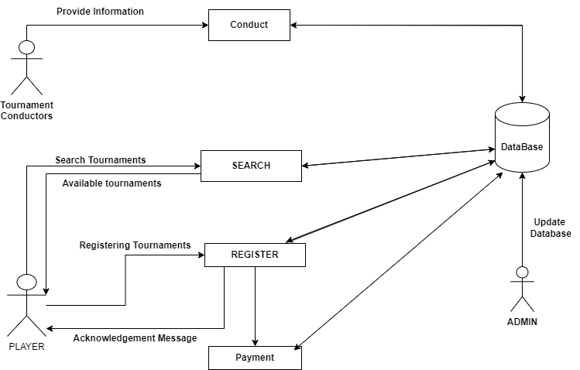
ARCHITECTURE DIAGRAM

Slide 10
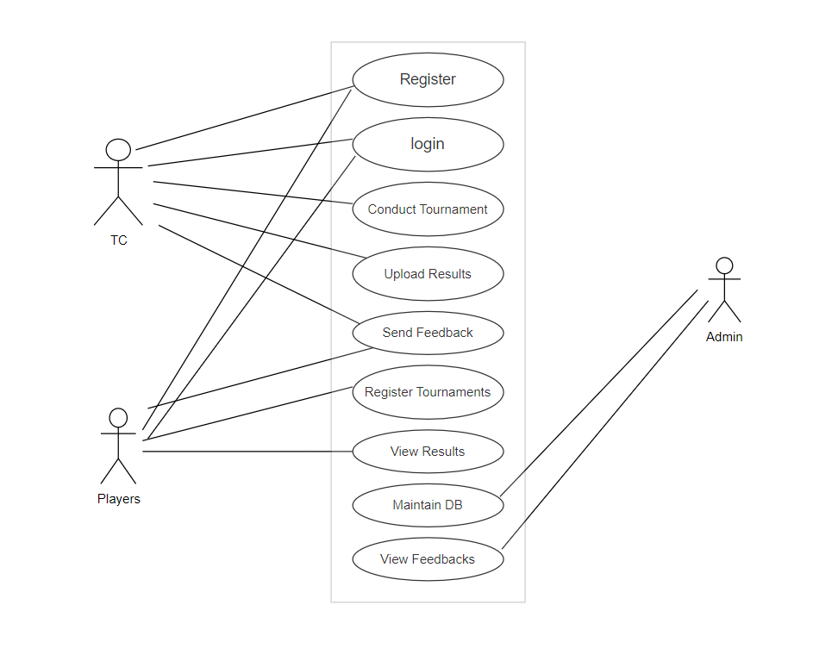
USE CASE DIAGRAM

Slide 11
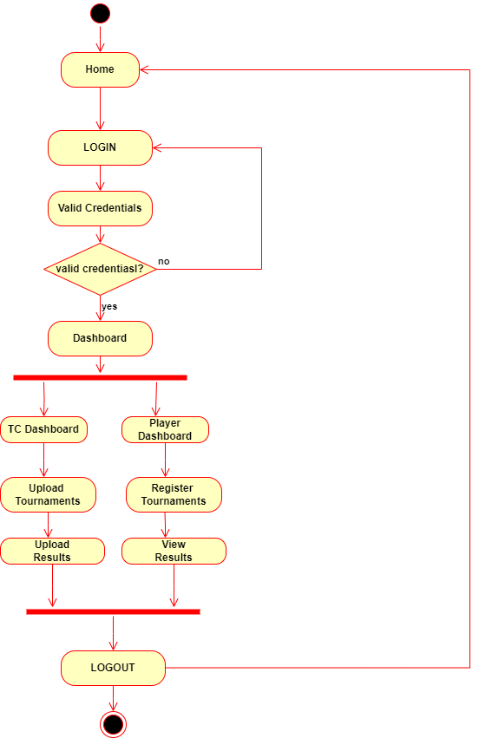
ACTIVITY DIAGRAM

Slide 12
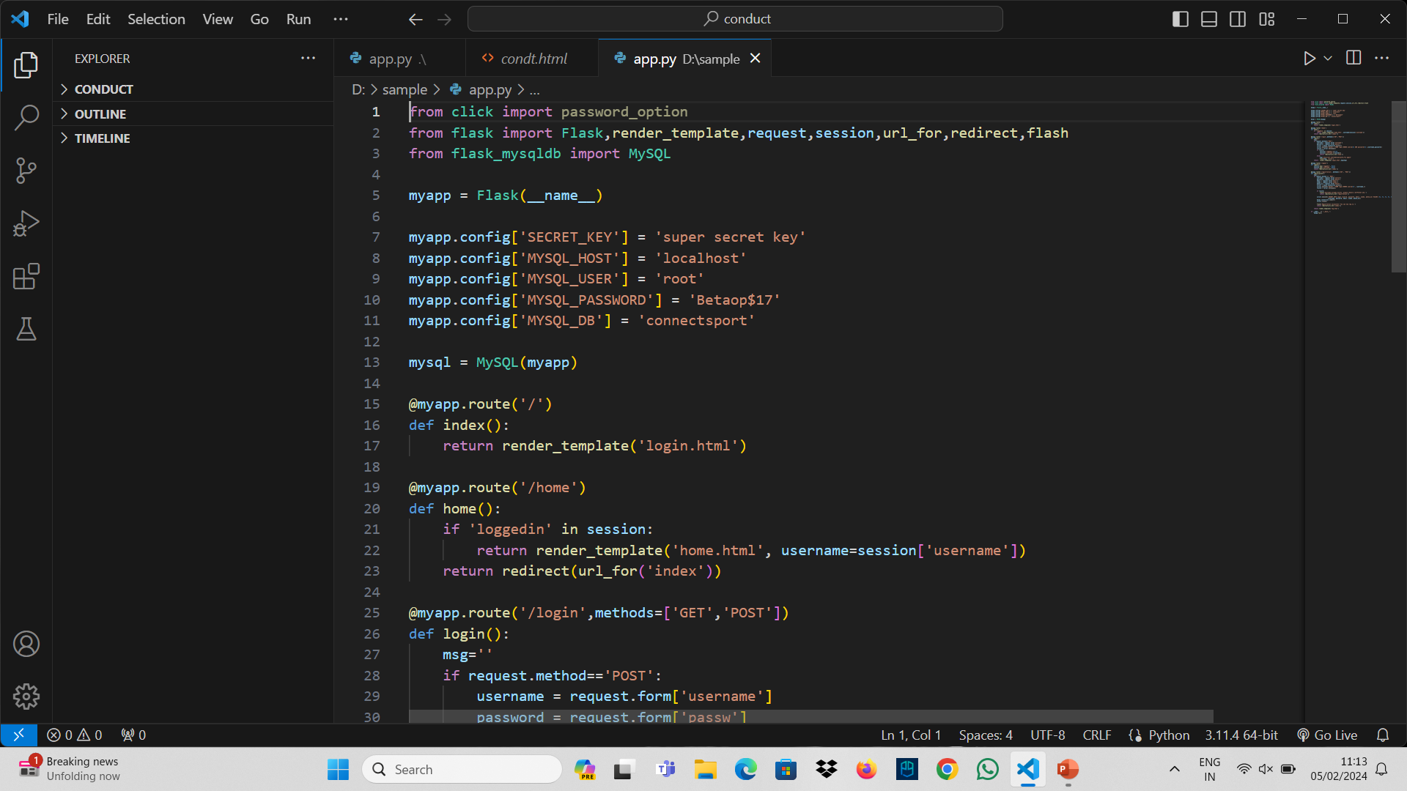
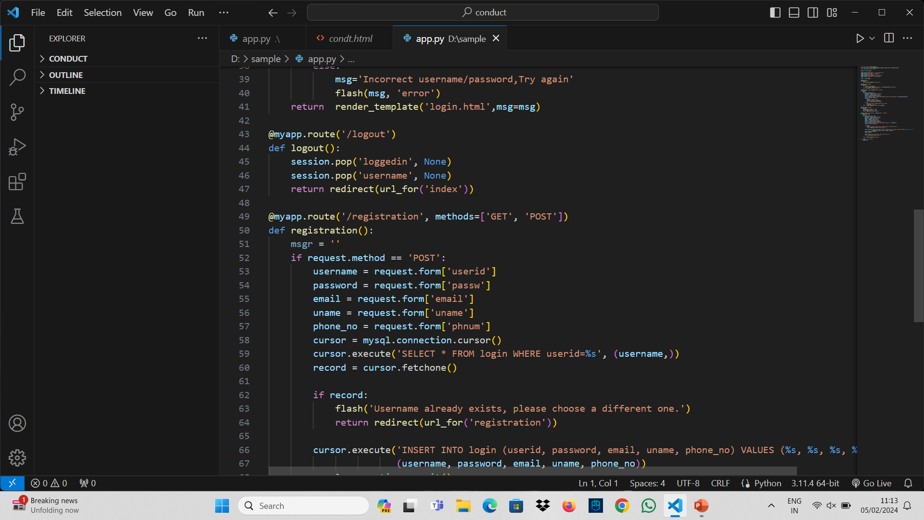
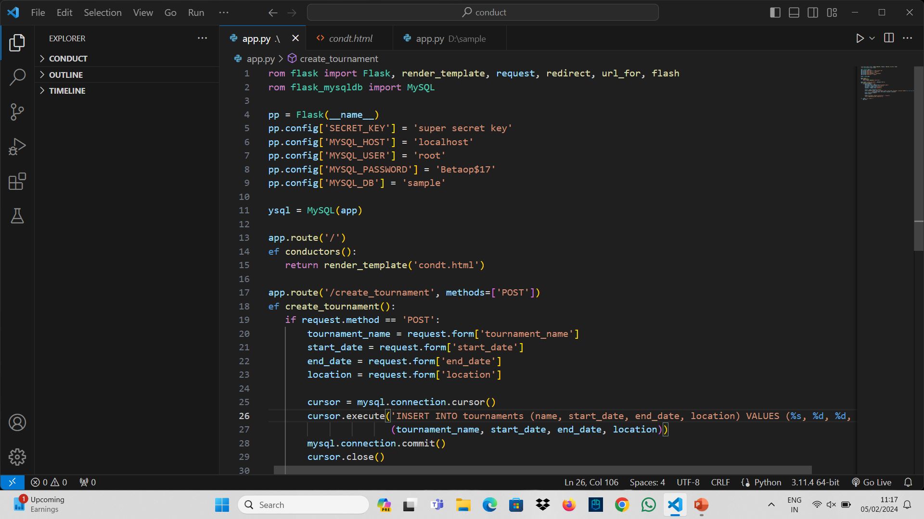

Slide 13
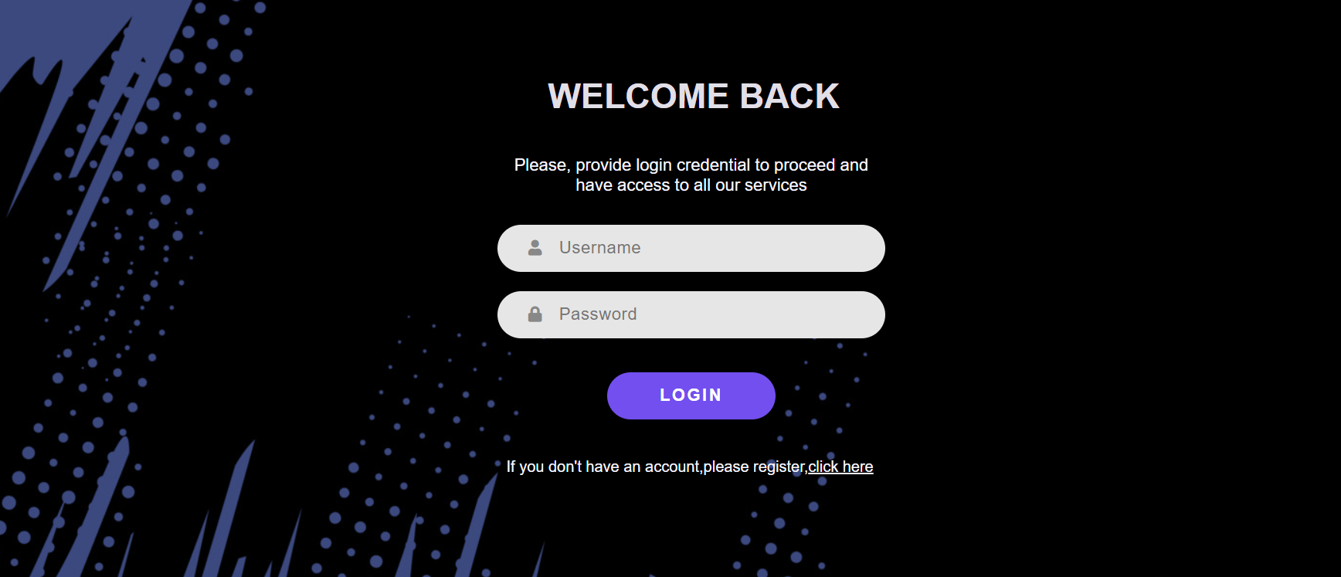
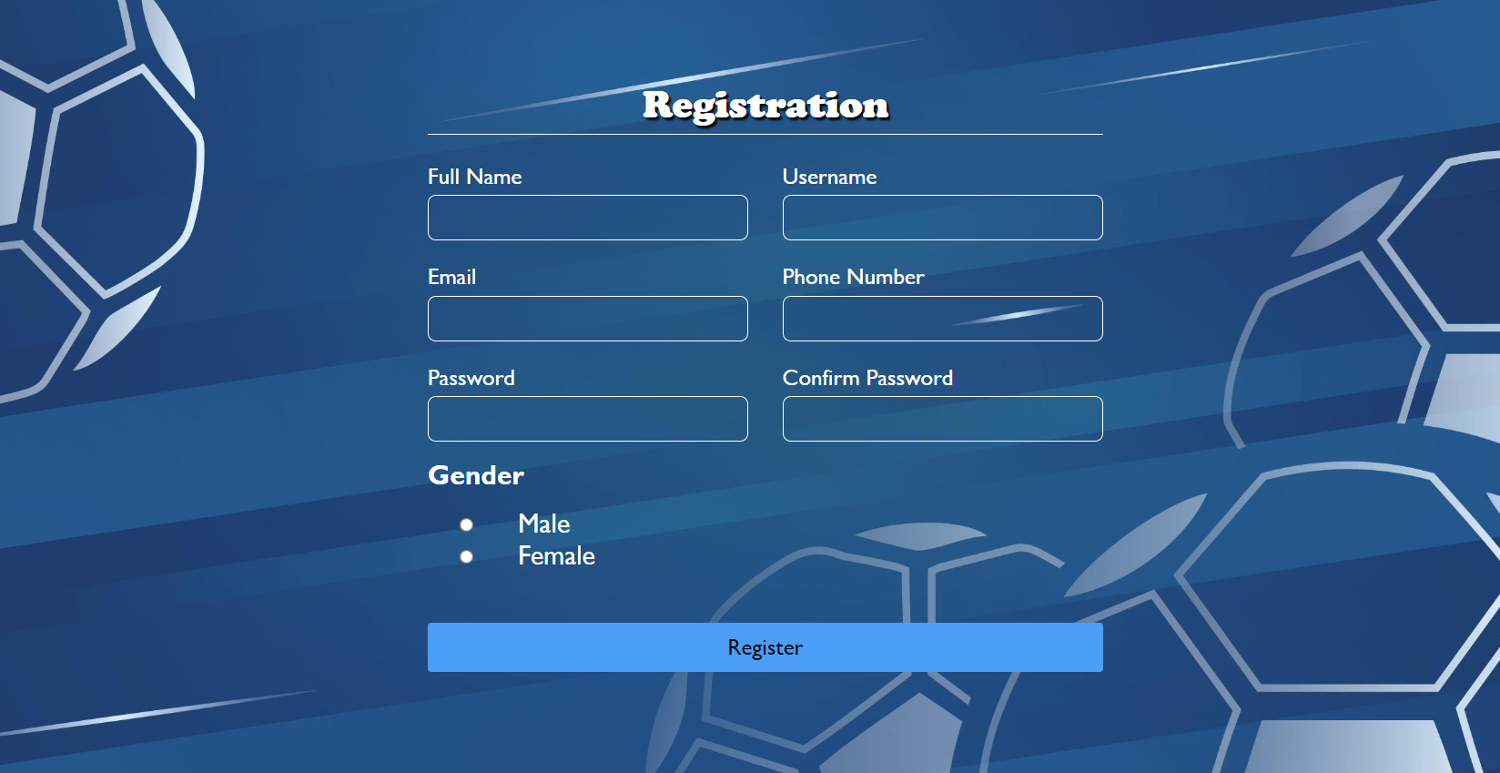

Slide 14
